Slide 1
A) Inconsistent Alarms
P<0.001
*
*
*
*
*

Slide 2
B) Consistent Alarms
P=0.004
*
*
*
*
*

Slide 3
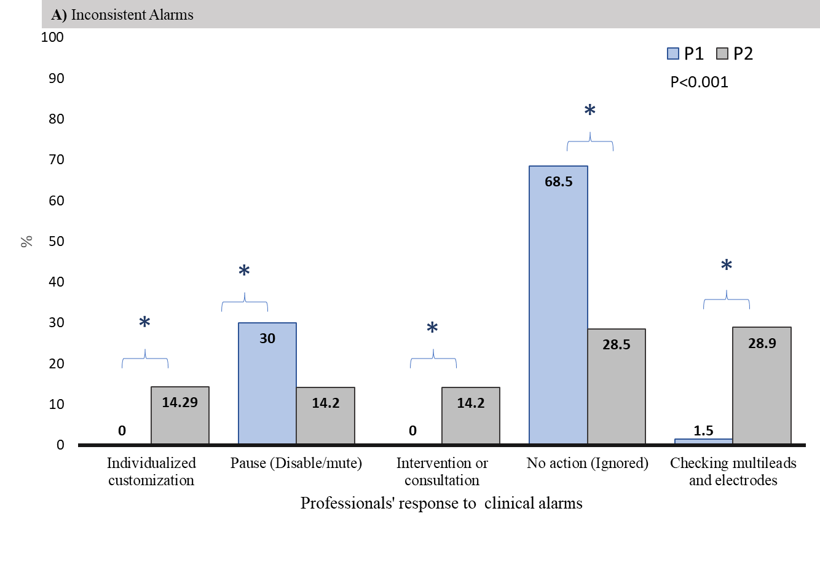
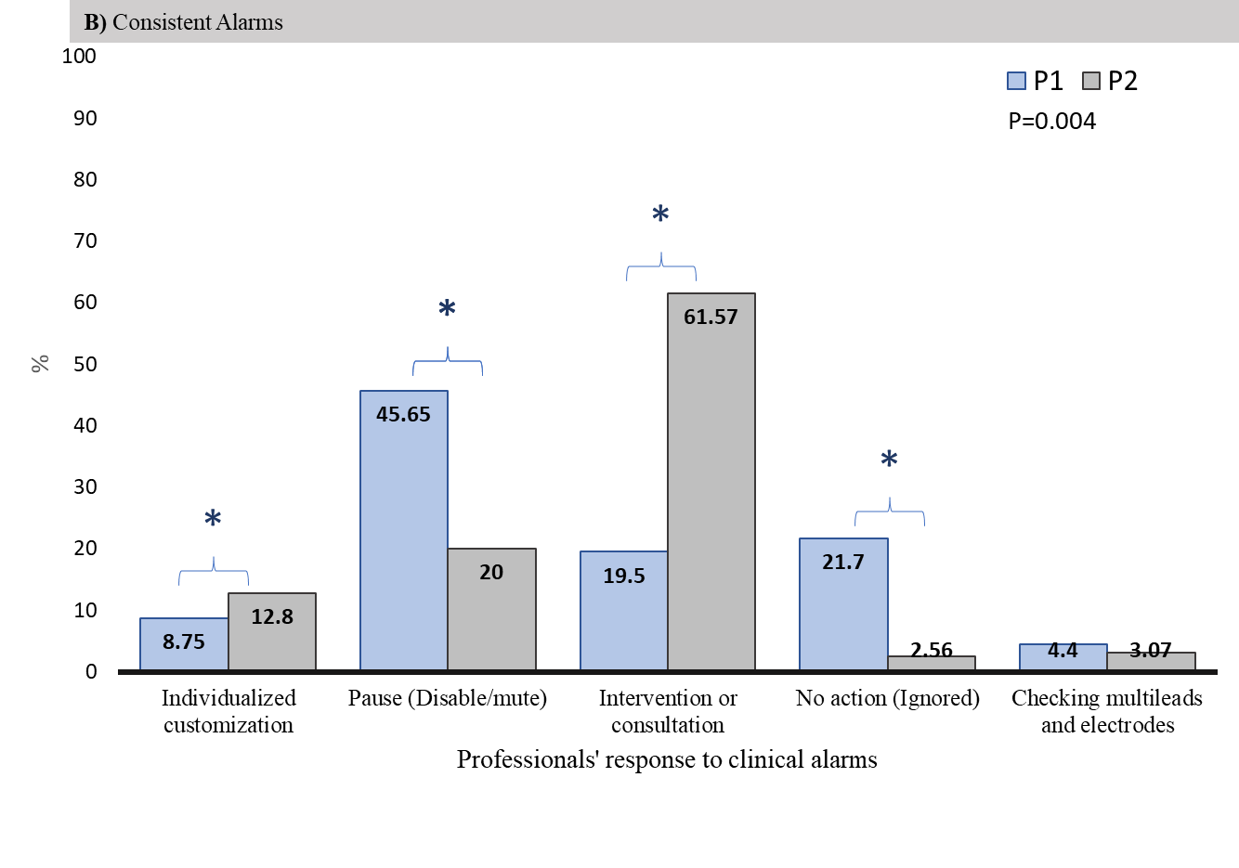

Slide 4
*

Slide 5
P-value
ASA-PS Classification
Gender
Age (Years)
P2

Slide 6
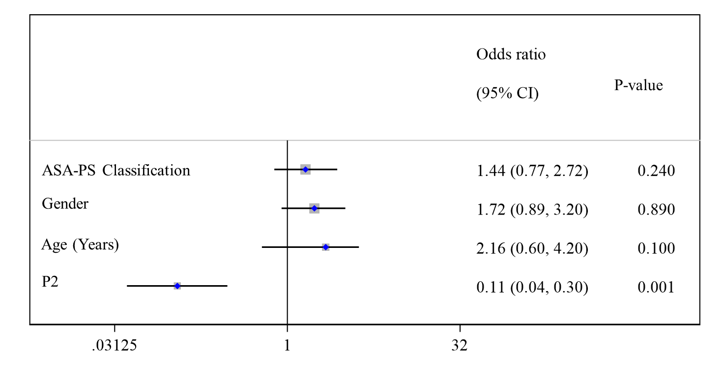

Slide 7
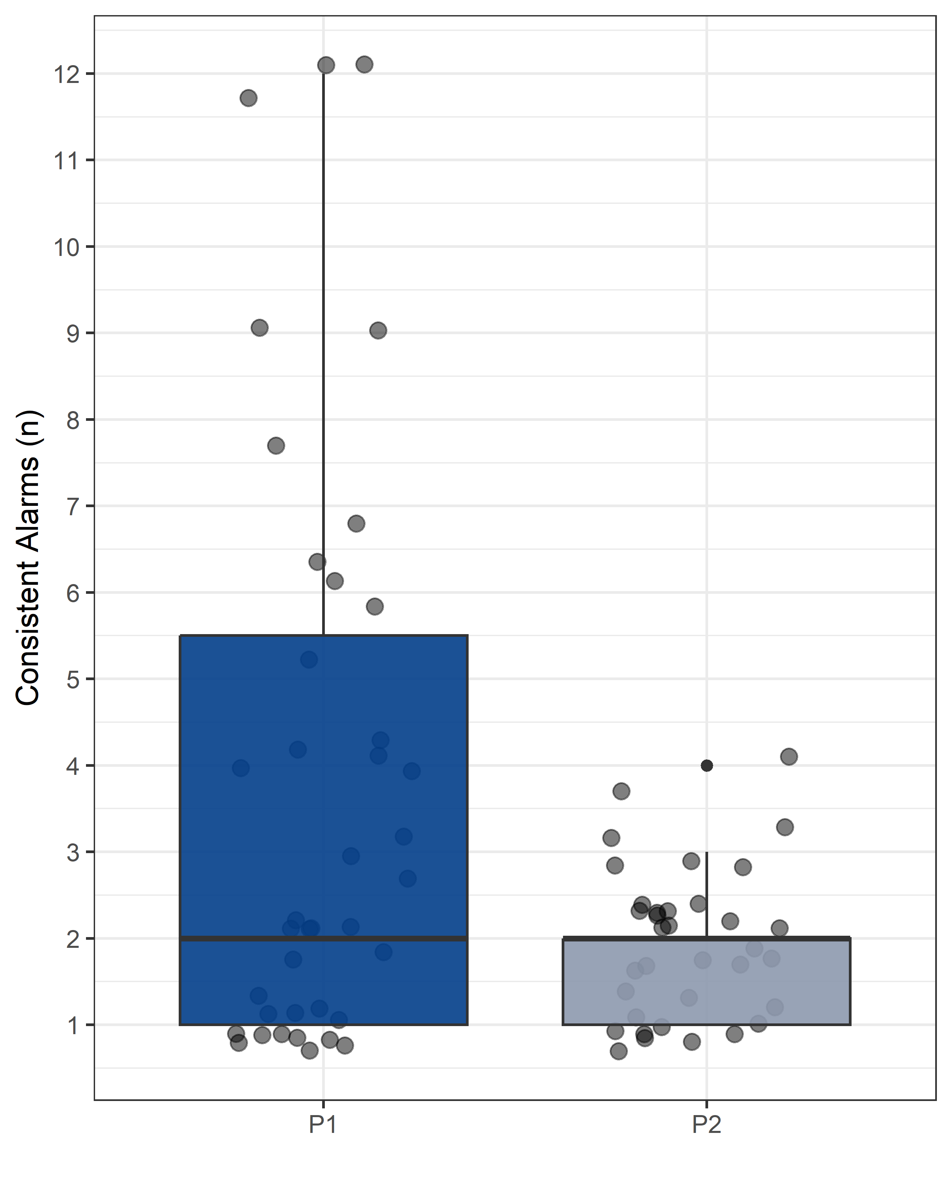
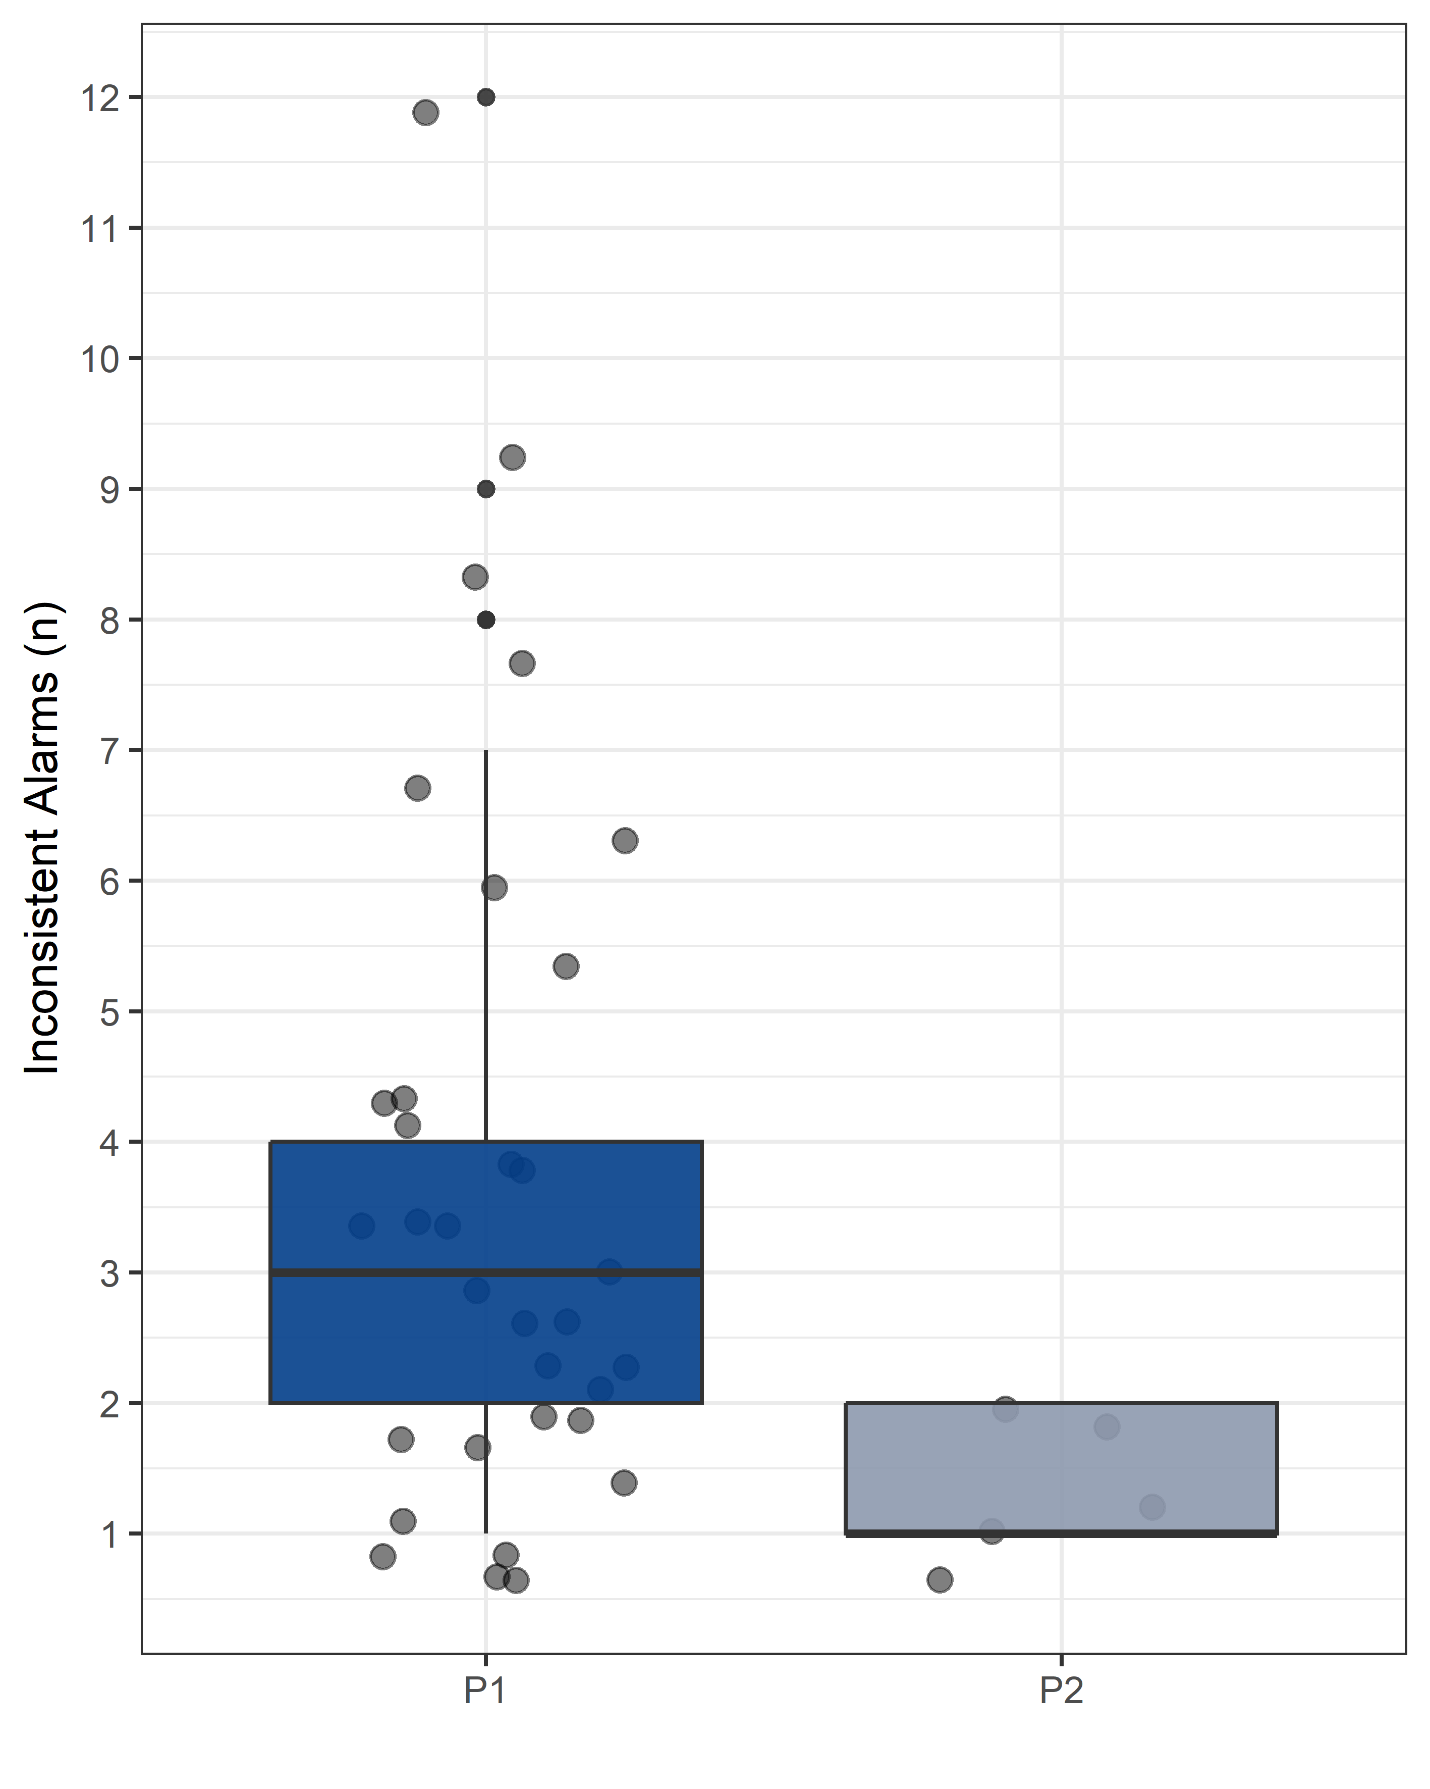
P=0.05
P=0.02

Slide 8
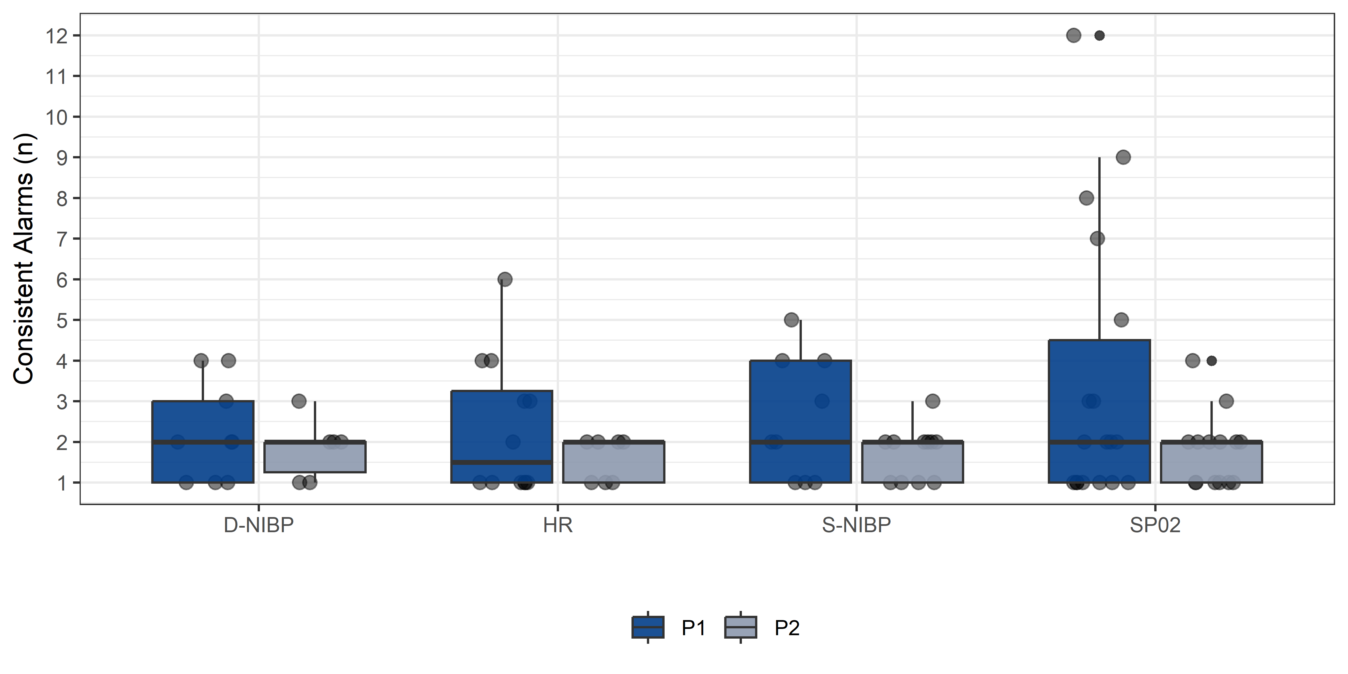
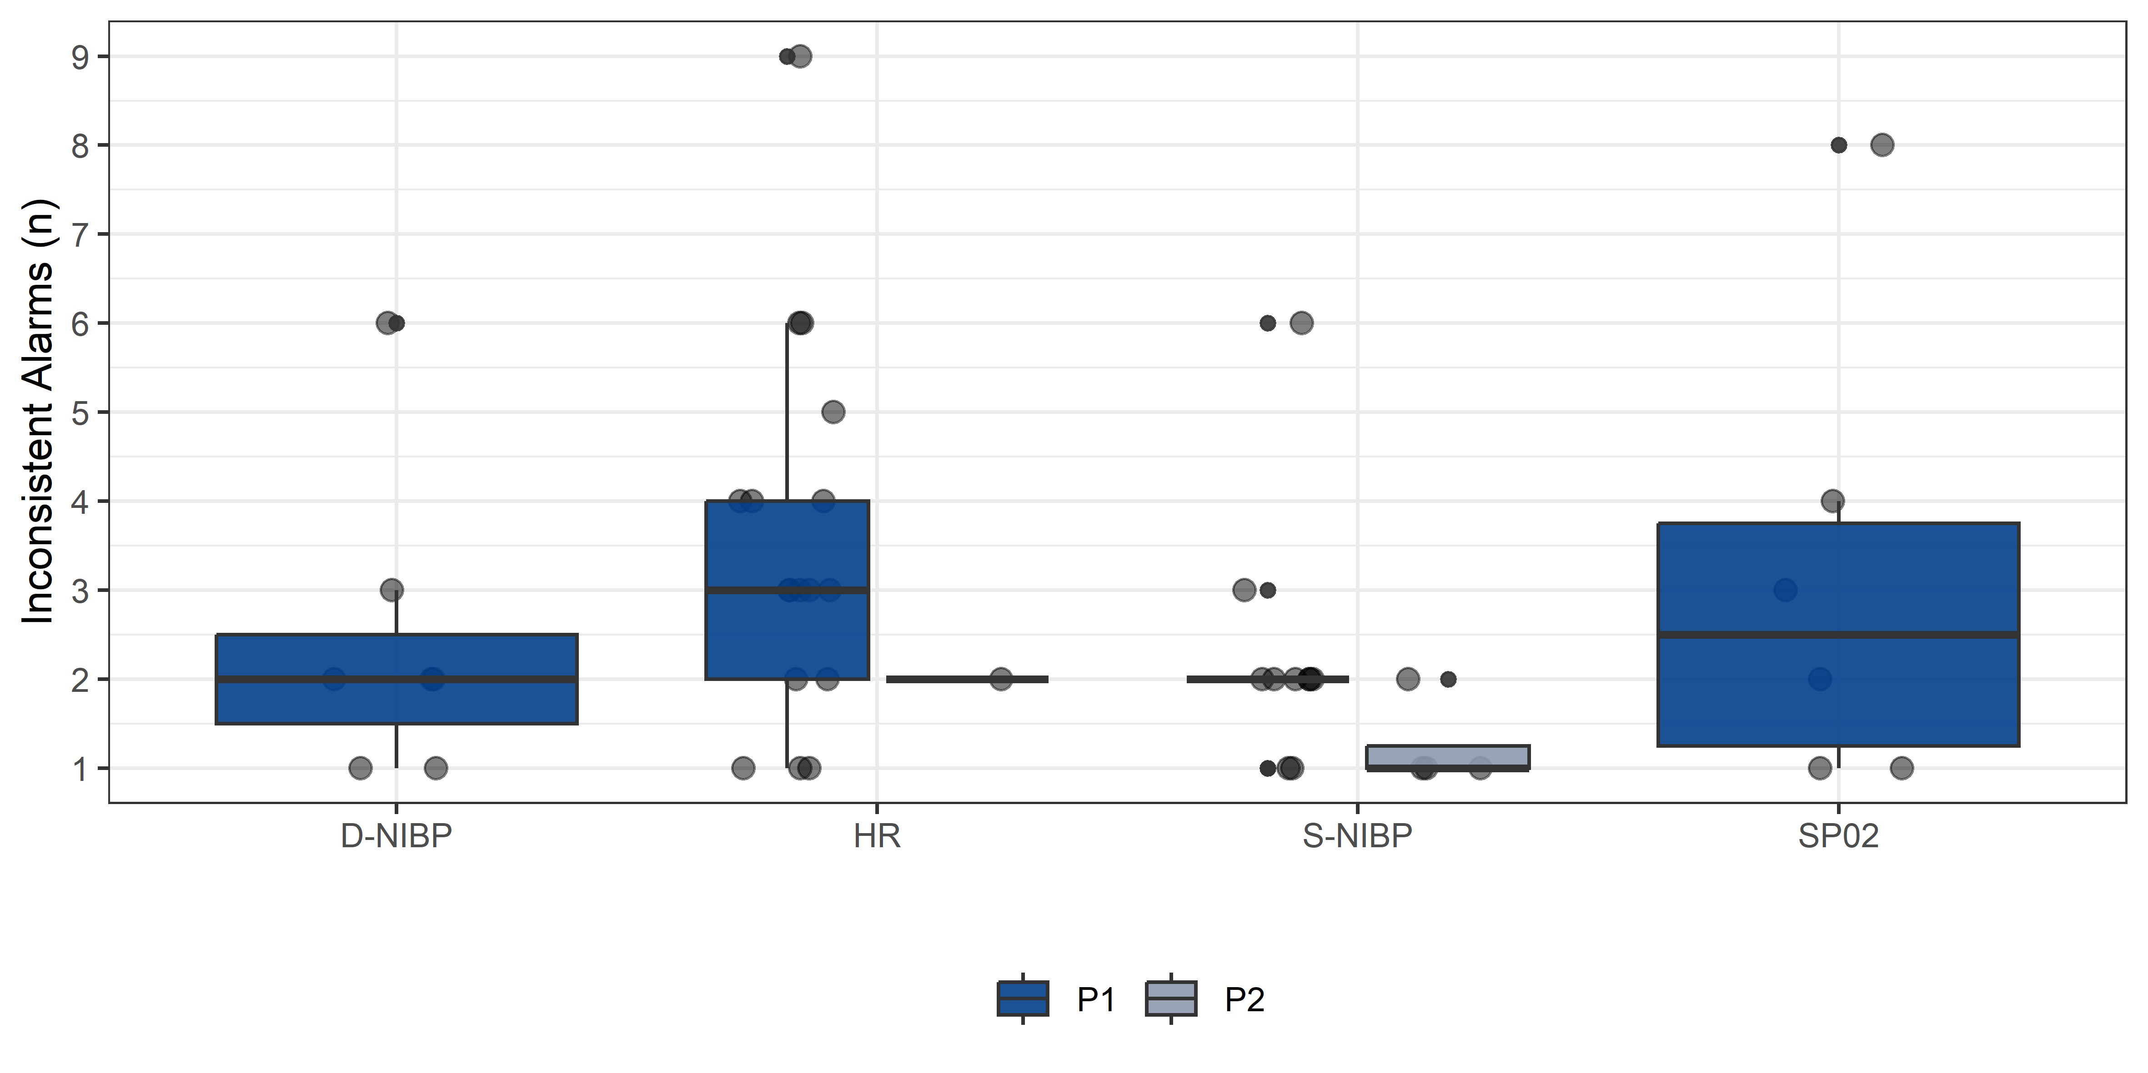

Slide 9
Elegible patients: (n=1562)
Patients admitted to PACU (Age>18 Years)
Assessed for elegibility
(n=264)
Excluded:
Patients with incomplete hemodynamic monitoring (n=4)
Included in the study
(n=260)
Follow-up:
26 consecutive day shifts
Usual care period
(P1)
13 consecutive day shifts
(n=130)
After intervention period (P2)
13 consecutive day shifts
(n=130)
The educational program was conducted over 4 days between P1 and P2.
Follow-up (1hour):
(n=130)
Follow-up (1hour):
(n=130)

